Slide 1
Notes:
My deep gratitude for being here today and I feel so honoured and privileged to be among you.
It is indeed a pleasure for me to welcome you to this session on “ Palliative care“ - Living as well as possible - for - as long as possible.
There are so many persons to thank for. To name a few -Vishnu, Vishnu and Vishnu.

Slide 2
Disclosure
I have NO
actual or potential
conflict of interest
in relation to this
presentation

Slide 3
Notes:
I have one confession to make.
That I am a learner and not an expert in Palliative Care.

Slide 4
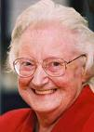
Founder of modern Hospice movement
Dame Cicely Saunders
1918-2005
St. Chrstopher’s Hospice, London
1967
Notes:
Founder of the Modern Hospice Movement, Nurse turned Social Worker, turned Physician. Prolific Writer and Visionary.
Established the first modern hospice in the suburbs of London.

Slide 5
Dr M.R Rajagopal
Chairman, Pallium India
Member, Advisory Committee on Palliative Care, Department of Health and Family Welfare, Government of India.
Government of India's Padma Shri award in 2018
Nominated for Nobel Peace Prize for the year 2018
Notes:
Please allow me to acknowledge my gratitude to my mentor Dr M R Rajagopal.
Dr M.R. Rajagopal is referred by many as the father of the palliative medicine in India for his outstanding contribution in this area.

Slide 6
Notes:
Let us start this evening with a little bit of good news and then also some bad news. Good news first and it is here.
There has never been a better time to be alive if what all you want is, to be alive. You can see here that the life expectancy at birth has increased dramatically during the last century after remaining more or less flat for over 10000 – in fact for the last 30000 years.
What made this possible. Any one?
Most of this increase was really because of improvement in public health. Safe water, good sanitation and better nutrition. And of course vaccination, antibiotics and then advances in modern medicine played their part.
So that is the good news.

Slide 7
Notes:
So what is the bad news? In spite of all the amazing advances in medical science, diagnostics, therapeutics, technology and everything else, World death rate is holding steady at 100%. And worse, there is no real plan to change that in the near future.
That is the real challenge we face, as not only medical professionals but also as human beings. Life is long and life is wonderful, and yet, life is limited. That is the reality we all live with. It is a challenge, but we can also argue that it is a gift. Because it reminds us the need to do our best in the limited time that we have, to spend it the way we want to, - doing things that are most important to us.
The challenge of long life brings us face to face with - living with chronic or serious illness.

Slide 8
Serious illness and End-of-life Care 100 years ago
Chronic illness was uncommon
There were no treatments
Death was like the weather – unpredictable
Came quickly and unexpectedly
A Brief acute illness at relatively young age by today’s standards
Notes:
It is interesting to look at the historical perspective to see what longevity has done to our experience of serious illness and end of life.
100 years ago, chronic illness was uncommon. They did not have diabetes or heart disease for very long. There were no treatments.. Death used to come quickly and unexpectedly. It came typically after brief illness at a very young age compared to today's standards.
Usually, illness experience was very brief , may be days , may be weeks or months – but not years that we experience today

Slide 9
The changing face of Serious illness and End-of-life
Today
Treatment for serious illnesses help people live longer and with better quality of life
Exacerbations and hospital admissions are the norm
Death comes after years or even decades of serious or chronic illness
Challenge
To help people achieve the best possible QOL for as long as possible and consistent with their goals and preferences.
Notes:
What does it look like today.
TODAY

Slide 10
Notes:
Just for a moment can you imagine your own end-of-life.
Modern Medicine at the fullest.
Lying on the bed, all alone, Lots of monitors, machines, tubes coming in and out. Surely this is not what we want for ourselves or for our loved ones, at the end-of-life.
How we can make things different to patients who do not want to end up this way. Particularly when such care is known to be futile.
One way is to talk to the patients and their families about what they want to go through and not, if they get sick like this. So communications / conversations are such an important part of Palliative care.

Slide 11
The nature of suffering and the Goals of Medicine
“The relief of suffering and the cure of disease must be seen as twin obligations of a medical profession that is truly dedicated to the care of the sick. Failure to understand the nature of suffering can result in medical intervention that (though technically adequate) not only fails to relieve suffering but becomes a source of suffering itself.”
Eric J. Cassell
Emeritus Prof. of Public health, Weill Medical College of Cornell University
Notes:
Modern Medicine despite all its tremendous advances and consequent benefits , can also create serious challenges.
This is best summarised by Eric J Cassell in 1985.
-Slide-

Slide 12
The author of the best selling book “Being Mortal”
Notes:
The challenge is that , there is mismatched care for the seriously ill.
Try to look at this article by Atul Gawande in New Yorker. The author of the best selling book “Being Mortal”.
If there is any one who did not read “Being Mortal”. Please do. Not necessarily for your patients. But for the benefit of yourself and your loved ones.

Slide 13
Medical Care of the seriously ill Many times
People receive care
They do not want
From which they can not benefit
People fail to receive care
They do want
From which they will benefit

Slide 14
We are going to discuss
Definition
Why it is important
Components
Notes:
In this presentation, I will be talking to you about Definition, a little bit of evidence . Also
“why palliative care is so important to the patients”.
Also a quick look at the important constituents of Palliative care.

Slide 15
What Palliative Care is NOT
End-of-life care
Notes:
I am about to give you the single most important take home message of this topic. That is “What Palliative Care is not”.

Slide 17
Notes:
Palliative care aims at all the whole person care , by focussing on physical and also non-physical causes of suffering.

Slide 18
To whom Palliative care is appropriate
Any Age
Any Diagnosis
Any Stage of the disease
Any Prognosis
Any Care Setting
Clinic
Hospital
Hospice
Home

Slide 19
Palliative care can be appropriate for the following and many more …
Malignancies
Neuro-degenerative diseases
Organ failures
Renal Failure
Hepatic Failure
Heart Failure
Respiratory Failure
Frailty
HIV / AIDS

Slide 20
Notes:
This is a model of concurrent palliative care.
Palliative care can be delivered concurrently with life prolonging therapy or as the main focus of care when life prolongation therapy is no longer possible or not affordable, not accessible or not wanted by the patient.
Palliative care can help distressed patients and their families during transitions in goals of care. From cure to life prolongation and when life prolongation is not possible the end-of-life care.

Slide 21
Concurrent model of Palliative Care
Cancer Clinic at Massachusetts general hospital
151 people with a new diagnosis of Incurable cancer (NSC- Lung)
All people received standard best chemotherapy
Half of people randomly assigned to also receive simultaneous palliative care
Temel et al. NEJM 2010:363:733-42
Notes:
Randomised control study done at Harvard , Massachusetts general hospital, they took patients with metastatic NSC lung cancer , that is a non-curable disease at the time of diagnosis, but chemotherapy is helpful, and all these patients who went to the trial received standard chemo therapy. Half of those patients were randomised to receive palliative care at the same time.

Slide 22
Evidence of Benefit
Better quality of life
Improved symptoms: pain, dyspnoea, nausea
Less depression
Less likely to receive aggressive care at the EOL
Longer life by 2.7 months on average survival: 11.6 vs 8.9 months.
Temel et al. NEJM 2010:363:733-42
Notes:
Tremendous improvement in QOL and longevity. Benefit as good or even better than that of chemotherapy.

Slide 23
Burden of health related suffering

Slide 24
Notes:
Report of the Lancet Commission on Global Access to Palliative Care and Pain Relief
The burden of serious health-related suffering is huge and could in large part be alleviated with palliative care and pain relief.
About 25·5 million of 56·2 million people who died in 2015 experienced serious health-related suffering, and
another 35·5 million experienced serious health related suffering due to life-threatening and life-limiting conditions.
About 80%) of these individuals live in low-income and middle-income countries with severely limited access to any palliative care, even oral morphine for pain relief.

Slide 25
Palliative Care: What patients need …
Palliation of symptoms
Clear communications
About illness, treatment and help with making decisions
Psycho-social support
Emotional, Social and Spiritual
Steinhauser et al. Ann Int Med 2000:132:825-32
Singer et al. JAMA 1999:281:163-8

Slide 27
Prevalence of symptoms in serious illnesses
Notes:
Symptoms are very common in serious illnesses.
And surprisingly the symptom burden may be as much or even more in some of the non cancerous conditions. And many times they suffer the symptoms for a longer duration than in many cancers.

Slide 28
Palliation of symptoms- Conclusion
People with serious illness have many distressing symptoms that need treatment
Relief of symptoms is Job # 1
Ask about common symptoms
Treat aggressively
Notes:
If you do not relieve symptoms patients are focused on them and they cant really attend to what’s important when they have serious illness. Nobody wants to focus on their pain or their shortness of breath or their nausea or fatigue. That just gets in the way of what is important.

Slide 29
Palliation of symptoms
So many symptoms can be relieved by relatively simple interventions
Pharmacological
Non-pharmacological

Slide 30
Notes:
I would like to invite your attention to the “End-of-life care policy – An integrated plan for the dying – 2014”
A joint position statement of Indian Society of Critical Care Medicine (ISCCM) &
Indian Association of Palliative Care (IAPC)

Slide 31
Patient-Physician Communication: Why and How
Notes:
Patient-physician communication is an integral part of clinical practice. When done well, such communication produces a therapeutic effect for the patient, as has been validated in controlled studies.

Slide 32
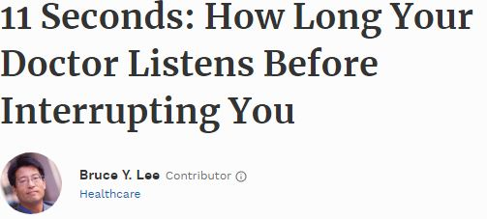
Study done at Mayo clinics and affiliated clinics in Minnesota and Wisconsin.
Journal of General Medicine
Notes:
It takes mammals on average 21 seconds to pee regardless of their size.
This study reveals that doctors interrupted their patients during their conversations after an average duration of 11 seconds.
Listening is the most important component of communication.

Slide 33
Common communication scenarios in advanced progressive illnesses
Breaking bad news
Transition to best supportive care
Discussing resuscitation
Discussing prognosis
Discussing place of care
Request for non-disclosure of diagnosis / prognosis
Request for “futile treatment”
Request for euthanasia / hastening death
Notes:
Common communication scenarios encountered while managing advanced progressive illnesses Include but are not limited to

Slide 34
Discussions about End-of-life care are good for patients and families
They are associated with
Better quality of life near death
Fewer invasive interventions
Better outcomes for caregivers

Slide 35
Psychological support
Non-abandonment
Hope
Bringing closure to important relationships
Spirituality

Slide 36
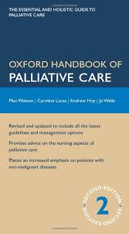
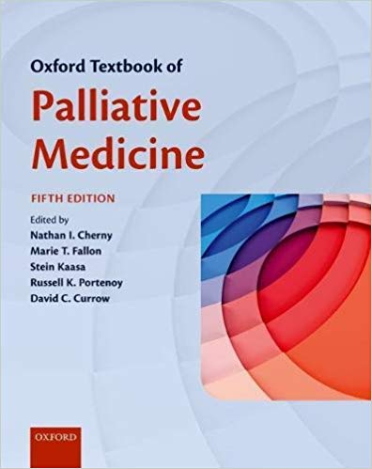
Palliation of symptoms- Resources
Many resources exist to guide symptom management both in the Palliative care world and literature.
Notes:
This part of this presentation is based on a video presentation available in YOUTUBE. There are four modules. Introduction to palliative care, Symptom control, Clear Communications and Psycho-social support. By Dr Steve Pantilat, Professor of Medicine, Director of Palliative care program, UCSF School of Medicine.

Slide 37
Notes:
The access to palliative care in India is an appalling 1% or less.
India comes near the bottom of the global league in access to end-of-life care , ranked 67 out of 80 countries in 2015.

Slide 38
Kerala
3% of India’s population
Two-third of the palliative care initiatives of the country.
More than 200 community based organizations running palliative care initiatives in the state in addition to the 300 Government palliative care initiatives.
Notes:
The Calicut model has become a WHO demonstration project, serving as an example of low cost and high quality Palliative Care delivery in the developing world based on cooperation between government, nongovernment organizations and the community

Slide 39
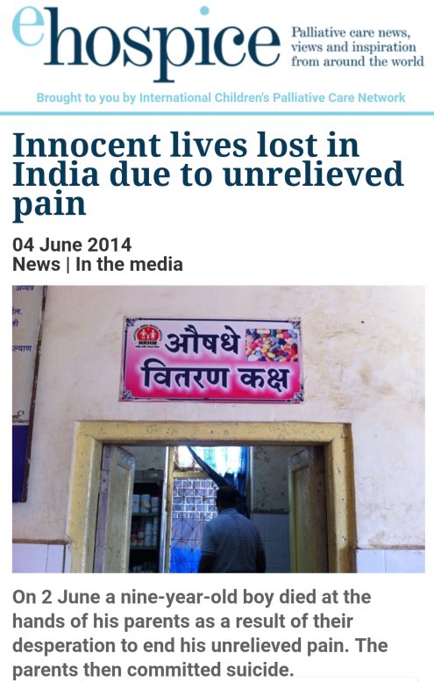
Notes:
The 2 June edition of The Times of India reports on the death of nine-year-old Karthik at the hands of his parents while in a hospital at Kanhangad in Kasaragod district, where the boy had been undergoing treatment.
His parents, Thampan and Padmini of Mundakkandam near Cheruvathur, then killed themselves.
A suicide note at the scene said the parents had decided to take the extreme step because they were unable to tolerate their son’s pain

Slide 40
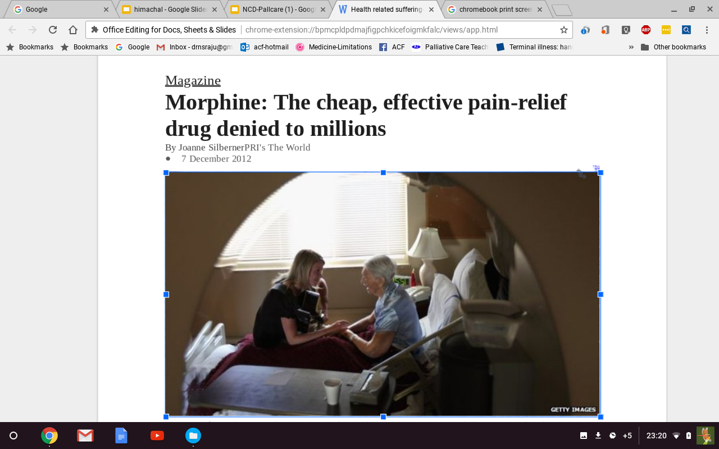
Notes:
Oral Morphine is cheap, effective and convenient drug to treat moderate to severe cancer pain.
Two important barriers for access to palliative care
1) Lack of professional education
Pain management is not a part of the medical curriculum which has resulted in the poor awareness about opioid drugs in the medical community. More than one generation of doctors and nursing professionals are totally unfamiliar with the use of opioids
.2) Lack of availability of opioid analgesics
Few hospitals are willing to procure, store and dispense morphine and other opiods even though their use is permitted for pain management, especially in cancer patients. This is because of the need to keep detailed records of procurement and use, increasing the amount of paperwork to be done.

Slide 41
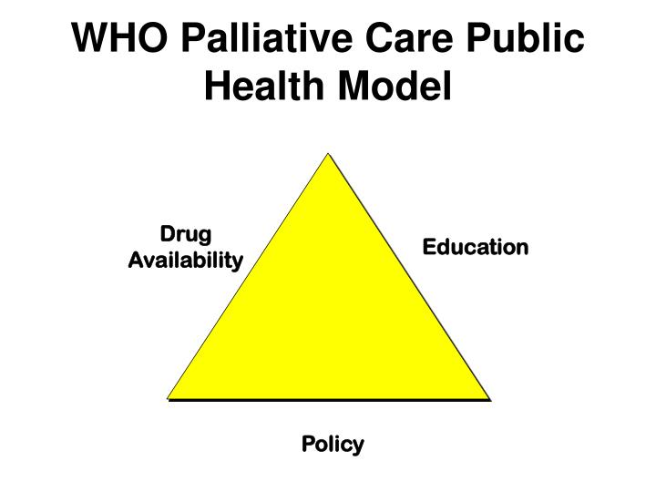
Notes:
Policy: National, State and Institutional policies.
Education: Doctors, Nurses, Pharmacists, Allied professionals, Volunteers, Social workers.
Drug availability: Morphine is in the essential medicines list of WHO, Central Govt. and also State Govt. But availability is very limited.

Slide 42
Although cancer pain relief was identified as one of the basic services provided at the primary health centers in the country in the National Cancer Control Program in 1984, the practicality of this goal was negated with the new NDPS Act. As many as six licenses were required for every consignment of morphine, and physicians possessing opiates after expiry of license could face arrest without bail and a jail term of up to 20 years. The use of morphine decreased from 716 kg in 1985 to a mere 18 kg by 1997 Data obtained through Pain and Policy Studies Group: University of Wisconsin/WHO Collaborating Center
Narcotic Drugs and Psychotropic Substances (NDPS) Act in 1985

Slide 43
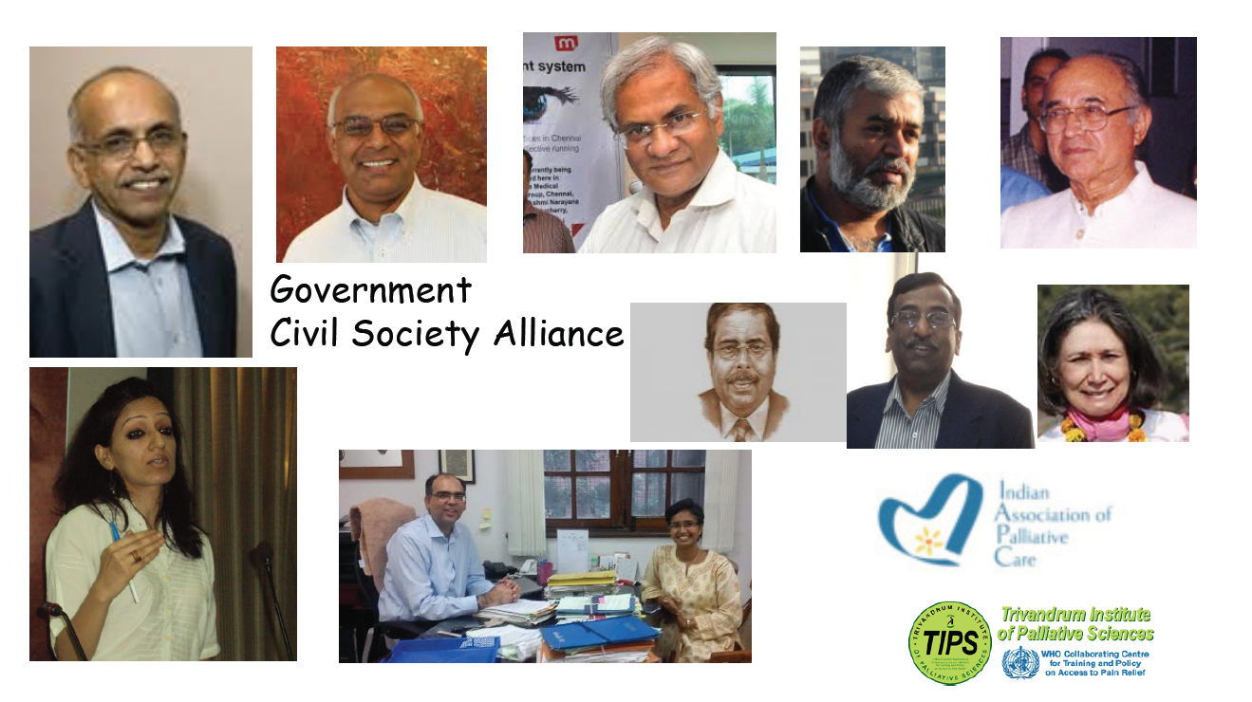
Notes:
Civil society – driven drug policy reform for Health and Human welfare and also judicial intervention led to declaration of National Palliative care strategy in 2012,
And Landmark amendment to NDPS act in 2014.

Slide 44
Notes:
The amendment made procurement, transport, possession and dispensing narcotic drugs much easier. Now the rules are uniform all over India. The power of legislation now squarely rest with GOI. And we need only one license for this purpose if registration is obtained as R.M.I.

Slide 45
Notes:
Morphine equivalent consumption of strong opioid analgesics ( excluding methadone) is an accepted indicator for assessing the Access of Palliative Care.

Slide 47
Tata Memorial Hospital, Mumbai
Total number of patients seeking Cancer care per year | 3,40,000
Out of them persons with advanced disease (70%) | 2,38,000
Out of above persons with moderate to severe pain (66%) | 1,57,000
If all of them receive morphine @72 mg/day for 3 months the requirement for TMH per year will be | 1017 kg
Total consumption for whole of India in the year 2014 is less than | 300 kg
Notes:
It is estimated that India needs about 36,500 kg of morphine per year, if the needs of all those patients who are suffering from moderate to severe pain are met . During the course of serious illness or end of life.

Slide 48
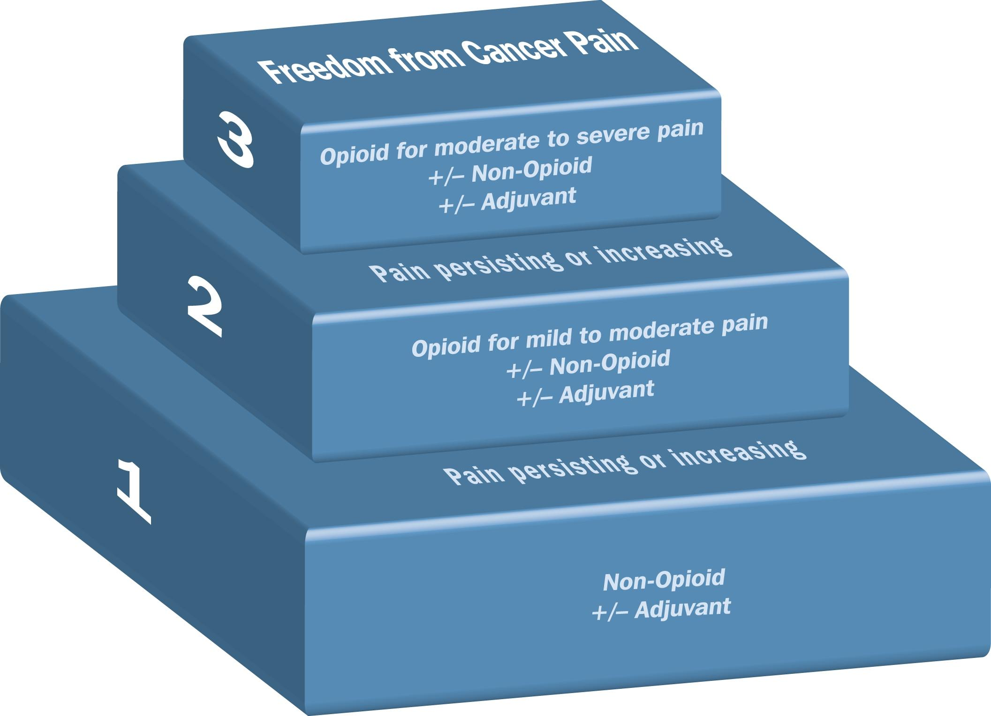
WHO – Pain Ladder (1986)
Notes:
It was developed for Cancer pain relief to adults. It was neither part of our education or practice in India.

Slide 49
Notes:
Palliative care as an approach and Palliative care as a discipline
Family physicians, nurses, paramedics, social workers and others should possess basic palliative care knowledge, skills and attitudes pertinent to the discipline.
In all primary care settings. Clinics, home visits, old age homes, small hospitals.

Slide 50
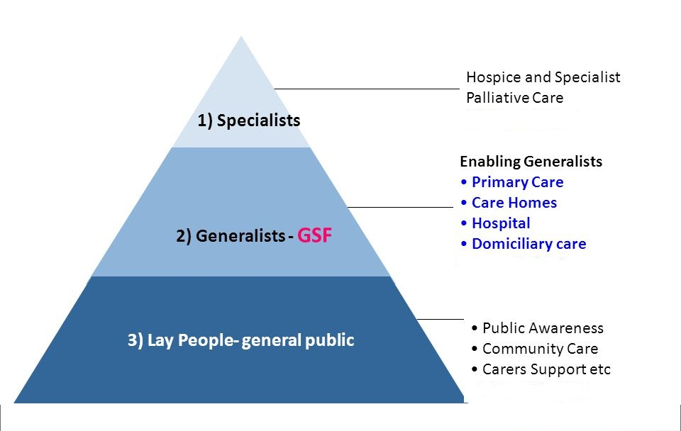
Notes:
Public awareness is also very important.

Slide 52
1. Pallium India a. Trivandrum Institute of Palliative Sciences (TIPS), Trivandrum. b. MNJ Institute of Oncology, Hyderabad 2. Institute Of Palliative Medicine , Calicut 3. Christian Medical College and Hospital, Vellore 4. Cipla Palliative care and training center, Pune 5. Tata memorial Hospital, Mumbai

Slide 53
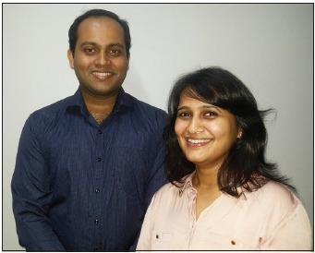
M.D. Palliative Medicine
TMC, Mumbai AIIMS, New Delhi GCRI, Ahmedabad
Notes:
MCI recognized “Palliative Medicine” as a specialty in the year 2010. The first course started in TMC, Mumbai in the year 2012.
First Qualified and trained Palliative medicine specialists from India Dr Arunanghsu Goshal and Dr Anuja Damani

Slide 54
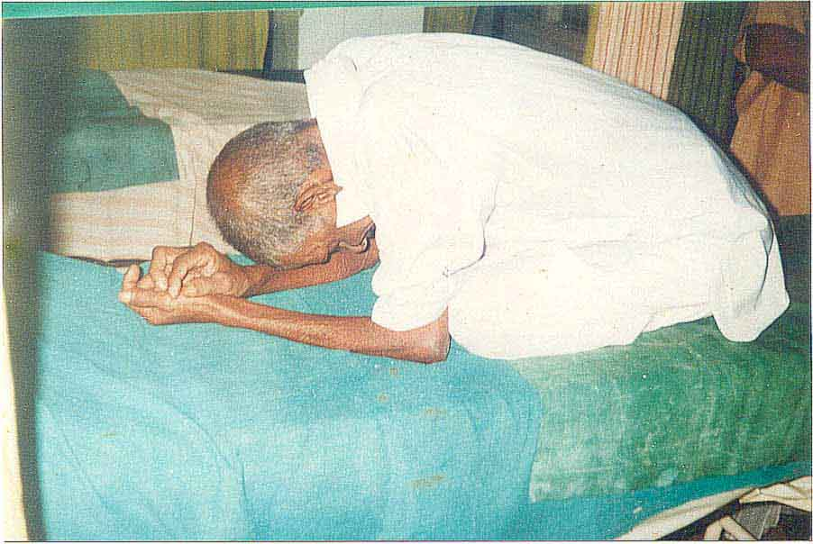
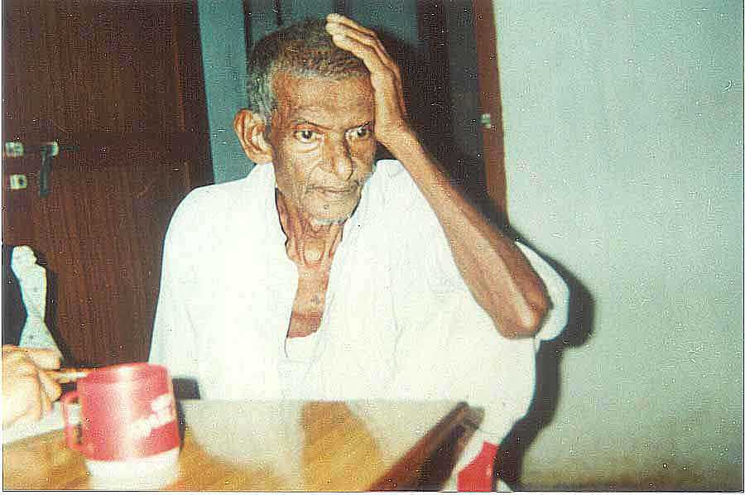
"Please, do not make us suffer any more…“
Presently Very Few Have a Pain Free and Dignified Death
Notes:
This elderly person on the left was in that posture for days and neither could sleep nor eat.
All it took to relieve his pain was Oral morphine 10 mg IR. Cost Rs.2.50/- He was having his first cup of tea after many days.
We have the necessary knowledge and drugs to relieve pain and suffering in most of the situations. Do we have the will.

Slide 55
Presently very few have a pain free and dignified death in India
The poor die in agony due to neglect
The middle class die in agony due to ignorance.
The rich die in agony on ventilator
Dr Mitra , Eastern India Palliative Care
Notes:
Don’t turn away from this story because you don’t think you are like that poor family or that your life is not connected with theirs; or that you can get to the best hospitals. The best hospitals in this country would usually offer high-tech, expensive, painful intensive care to the dying person; but not pain relief. Less than 1% of hospitals in our country have oral morphine, which is classed as an essential medicine in the Government of India’s list.

Slide 56
Key features
Recognition and relief of
Pain & other symptoms
Psycho-social suffering
Spiritual / existential suffering.
Care & Support of care givers and family
Sensitive communications
Truth and honesty in all dealings
Multi disciplinary team

Slide 57
Conclusion
Palliative care is NOT end-of-life care.
Palliative care is medical care focussed on promoting quality of life for people living with serious illness
Palliative care should be provided along-side any other appropriate treatments.

